Slide 1


Institute of Petroleum Research (IPR-FORTH)
A new pole for Research and Innovation in the Eastern Mediterranean: The Institute of Petroleum Research (IPR) /Foundation for Research and Technology - Hellas (FORTH)
November 2020
Chania, Crete
FOUNDATION FOR RESEARCH AND TECHNOLOGY - HELLAS
Notes:
Ladies and Gentlemen, Distinguished guests,
First of all I want to thank the HAEE for the opportunity for us to participate in the Congress.
The presentation is about the IPR, as a new pole….

Slide 2
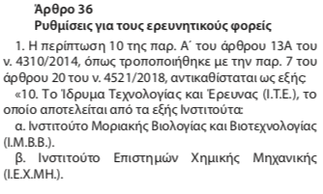
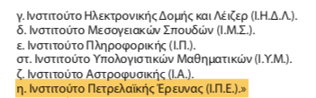
Institute of Petroleum Research (IPR-FORTH)
When? January 2019
The IPR-FORTH was established by the Greek Parliament (as per Law 4589 article 36.1)
Official Government Gazette
The official announcement, Chania, Jan. 21st , 2019
FOUNDATION FOR RESEARCH AND TECHNOLOGY - HELLAS
Notes:
We are talking about a new inst, which was …established back in Jan. 2019.
It is worth to say that the scientific board as well as the researchers of it, present with many years of experience in all disciplines covered by the Inst..

Slide 3
Institute of Petroleum Research (IPR-FORTH)
A New Institute, WHY ?
Expected intense growth of oil & gas activities in Greece and Eastern Mediterranean
Greece is a frontier, mostly unexplored for its hydrocarbons potential.
                The first independent, integrated scientific R&D body in hydrocarbons E&P in Greece, including E. Mediterranean
                A hub of technical, educational, economical and geopolitical significance
The new Institute may act as scientific advisor for Greek governmental bodies (Ministries, Region), may support them, sharing its expertise to International Fora (i.e. East-Med Gas Forum) and as coordinator of the existing petroleum research groups in the country
FOUNDATION FOR RESEARCH AND TECHNOLOGY - HELLAS
Notes:
But Why another Institute?
First of all, ….
Secondly considering that Greece is a frontier… There are Specific challenges d/t its complicated geology, the deep to ultra-deep water depths, the rough subsea morphology, connected to the active tectonic setting etc., while there should be an environmental friendly exploitation of oil reserves due to the highly developed tourism sector. This provides the inst with a lot of work…
Third, this is going to be … the first
This Institute may well be developed to … a hub of technical knowledge, to provide high specialized educational standards, to enhance the economic growth of the Chania /Crete and to underline, d/t its location, the geopolitical and geostrategic significance of the Island.
Last but not least, … the new Inst may act …

Slide 4
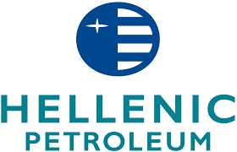
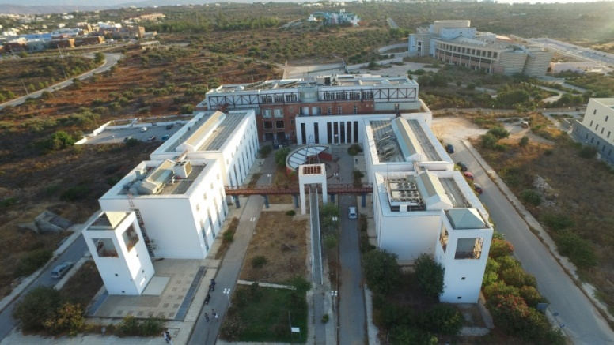
Institute of Petroleum Research (IPR-FORTH)
September 2020
As a host, the Technical University of Crete (TUC) allocated
500m² space for temporal housing of the new institute and
35 acres for the construction of permanent installations in the TUC Campus
  Financial Support
  through a Sponsorship agreement with “Hellenic Petroleum S.A.” (HELPE) for the next 5 yrs
Presently …
… the near future !!!
FOUNDATION FOR RESEARCH AND TECHNOLOGY - HELLAS
Notes:
Talking about the Inst, the TUC as a host allocated….
Renovation was made following the FORTH standards for safety & security.
Furthermore, a financial support under a Sponsorship Agreement by HELPE group, will enable us to move fast and secure the near future.

Slide 5
Institute of Petroleum Research (IPR-FORTH)
Main Research Directions
Oil
Gas
Petroleum Exploration
  Research for Oil & Gas onshore and offshore, in frontier areas, and petroleum basins (Geology, Geophysics, Geochemistry and more)
Petroleum Production
    Research in drilling and production of hydrocarbon reservoirs (Drilling Engineering, Production Engineering)
Safety and Environment
Research for safe and environmental sustainable exploration and exploitation of oil and gas (Environmental Engineering)
FOUNDATION FOR RESEARCH AND TECHNOLOGY - HELLAS
Notes:
Three are the main research directions of the new Inst., each with a separate Division.
Fundamental (basic) and applied ….

Slide 6
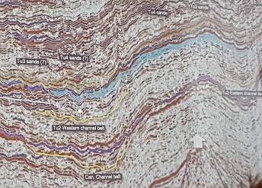
Institute of Petroleum Research (IPR-FORTH)
1. Exploration
Existing Capabilities (in collaboration with MRED–TUC)
Geophysical interpretation & Integrated system (equipment, methodologies, data evaluation) for geochemical studies in petroleum basins - compatible with common industrial standards. Unique in Greece.
Modeling of petroleum systems and basins, (including experimental kinetic modeling of kerogen) using advanced industrial software
Detailed characterization of petroleum fluids and sediments in source rocks and reservoirs, including GC, GC-MS, HPLC, Rock-Eval, DTG, CHNS analyses….
Output
More than 40 research papers, active in AAPG, ICE, EAGE
Applied research projects with oil, shipping & service companies, other Institutes and Regional Management Bodies
Semi-commercial library of petroleum biomarkers mass spectra
FOUNDATION FOR RESEARCH AND TECHNOLOGY - HELLAS
Notes:
Software (Petrel & PetroMod, Schlumberger)
We have also conducted .. Applied
There is developed a semi-

Slide 7

Institute of Petroleum Research (IPR-FORTH)
1. Exploration
Main directions of research
Biochemical processes of oil generation
Analysis and modelling of geophysical data
Modelling of hydrocarbons’ generation & migration
Study the onshore geological analogues vs offshore seismic structures & reservoirs
Palaeoclimate-palaeogeographic reconstructions and source rocks-paths
CO2 storage - CCUS
7
FOUNDATION FOR RESEARCH AND TECHNOLOGY - HELLAS
Notes:
Carbon Capture, Utilization, and Storage (CCUS) is a gas injection technology that enables the storage of CO 2 underground.

Slide 8
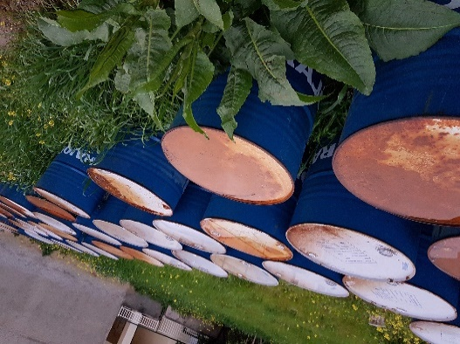
Institute of Petroleum Research (IPR-FORTH)
2. Production
Existing Capabilities (in collaboration with MRED–TUC)
Phase equilibria and thermodynamic behaviour (PVT, MMP, viscosity) studies of multiphase mixtures (ex. VLL, GH, asphaltenes) at high pressures and temperatures. HPHT density meter unique in Greece.
Core Analysis testing (permeability, porosimetry, water saturation)
Phase equilibria modeling for oil, gas and gas hydrates
Rheological measurements on oil-water emulsions and drilling/cement slurries
Flow assurance measurements in 5m long flow loop
Output
More than 80 published research works
Many applied research projects with oil companies
In house developed multiphase equilibrium simulator (HYDTUC) for gas/oil/brine/GH/ice
FOUNDATION FOR RESEARCH AND TECHNOLOGY - HELLAS
Notes:
The Production Division

Slide 9
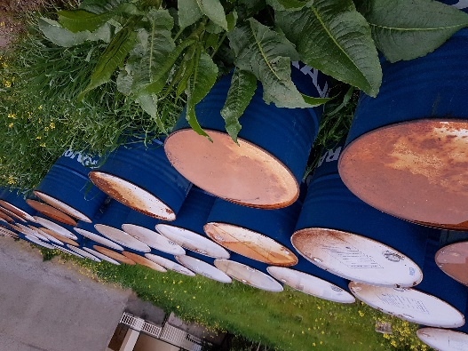
Institute of Petroleum Research (IPR-FORTH)
2. Production
Directions of research
Multiphase fluids and emulsions PVT data
Analysis and modelling of flow assurance issues
Integration of geophysical tools to existing core analysis and flow loop setup
Application: To act as scientific advisor/contractor to oil companies & the State/HHRM,
to carry out industrial projects (E & P Divisions of IPR)
9
FOUNDATION FOR RESEARCH AND TECHNOLOGY - HELLAS

Slide 10
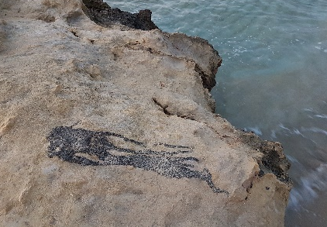
Institute of Petroleum Research (IPR-FORTH)
3. Safety and Environment
Existing Capabilities (collaboration with the EnvEng-TUC)
Research on the field of Bioremediation Technologies (biodegradation of hydrocarbon
contaminants on surface and deep waters – oil spills)
Sediments decontamination & environmental monitoring (landfarming)
Microbiological and molecular characterization of Hydrocarbon degrading bacterial communities (q-PCR, flow cytometry)
Modeling of oil spill fate and transport in the marine environment (MEDSLIK-III)
Output
Numerous publications, as well as patents
More than 10 EU funded projects on environmental clean up biotechnology (KILL SPILL)
2 Postdoctoral funded projects on Deep Sea bioremediation of hydrocarbons
Innovative product development for combating oil spills – bioremediation agents (bioPad, Biosurfer)
FOUNDATION FOR RESEARCH AND TECHNOLOGY - HELLAS
Notes:
Environmental Engineering Department of the Technical University of Crete

Slide 11
Institute of Petroleum Research (IPR-FORTH)
3. Safety and Environment
Directions of research
Biochemical processes of oil degradation
Environmental Biotechnology
Analysis and modeling of oil spill fate in the environment
Study of natural and old well leakages of Oil & Gas
Application: To act as an Offshore Petroleum Regulator for Environment / connect with the Private sector (Env. Protection & management companies and more) and Collaborate with the State Competent Authority for Offshore Safety in Oil and Gas Operations (HHRM) - Law 4409/2016
SEIA, EIA, EBR
11
FOUNDATION FOR RESEARCH AND TECHNOLOGY - HELLAS
Notes:
Moreover the Inst. May provide opinion on the usual env reports submitted during the Work Program of an awarded block

Slide 12

Institute of Petroleum Research (IPR-FORTH)
IPR is an energy research structure for Greece, established at the right point (location) and the right moment. The State should get asap advantage of it and grab the momentum. This is really a high reward Investment Opportunity !
Our values and goals
To present high operating standards & research excellence, coupled with sustainability
To keep and enhance IPR’s-FORTH credibility both in the scientific community and in the private sector (oil industry and beyond)
To evolve as the Key/Reference Center, for Oil & Gas R&D in East Med.
To strengthen the portfolio, broadening our experience, seeking New Projects & Collaboration Opportunities (CO2, CCUS, Gas Storage, Environmental monitoring & modeling …) in the direction of decarbonization and enrichment of the energy mix with Renewables
To provide high educational standards through its expertise
FOUNDATION FOR RESEARCH AND TECHNOLOGY - HELLAS
Notes:
Summarizing, Although the energy sector transformation procedure has started, it well known also that the transitional period to a carbon free Era will last for decades. In the meantime, gas and less oil will be part of the energy mix proportion.

Slide 13
Institute of Petroleum Research (IPR-FORTH)
Thank you for your attention
Institute of Petroleum Research (IPR) / FORTH
Technical University of Crete Campus, Building M1
73100 Chania, Crete
ipr@ipr.forth.gr
FOUNDATION FOR RESEARCH AND TECHNOLOGY - HELLAS

